Slide 1

Introduction to Operating Systems CS/COE 1550
Fall 2020
Sherif Khattab
ksm73@pitt.edu
(Some slides are from Silberschatz, Galvin and Gagne ©2013)

Slide 2
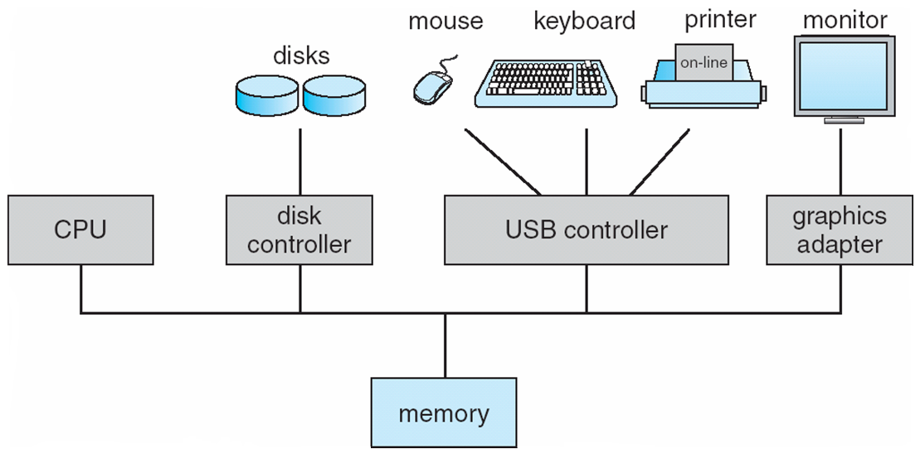
How complex is the OS’s job?
Let’s look at one of the resources managed by the OS: I/O devices

Slide 3
Outline
Device Drivers
I/O Device Example (Magnetic Hard Disk)
File System
File and Directory Abstractions
File System Implementation

Slide 4
Device drivers
Device drivers go between device controllers and rest of OS
Drivers standardize interface to widely varied devices
Device drivers communicate with controllers over bus
Controllers communicate with devices themselves
User space
User program
Kernel space
Rest of the OS
Keyboard driver
Disk driver
Keyboard controller
Disk controller

Slide 5
How are I/O devices connected?
Single-bus
All memory accesses go over a shared bus
I/O and RAM accesses compete for bandwidth
Dual-bus
RAM access over high-speed bus
I/O access over lower-speed bus
Less competition
More hardware (more expensive…)
CPU
Memory
I/O
CPU
Memory
I/O
This port allows I/O devices access into memory

Slide 6
Device controllers
Electronic component controls the device
May be able to handle multiple devices
May be more than one controller per mechanical component (example: hard drive)
Controller's tasks
Convert serial bit stream to block of bytes
Perform error correction as necessary
Make available to main memory
Block Devices
A device that stores data in fixed‐sized blocks, each uniquely addressed, and can be randomly accessed
Character Devices
Device that delivers or accepts a stream of characters

Slide 7
Layers of I/O software
User-level I/O software & libraries
User
Device-independent OS software
Operating system (kernel)
Device drivers
Interrupt handlers
Hardware

Slide 8
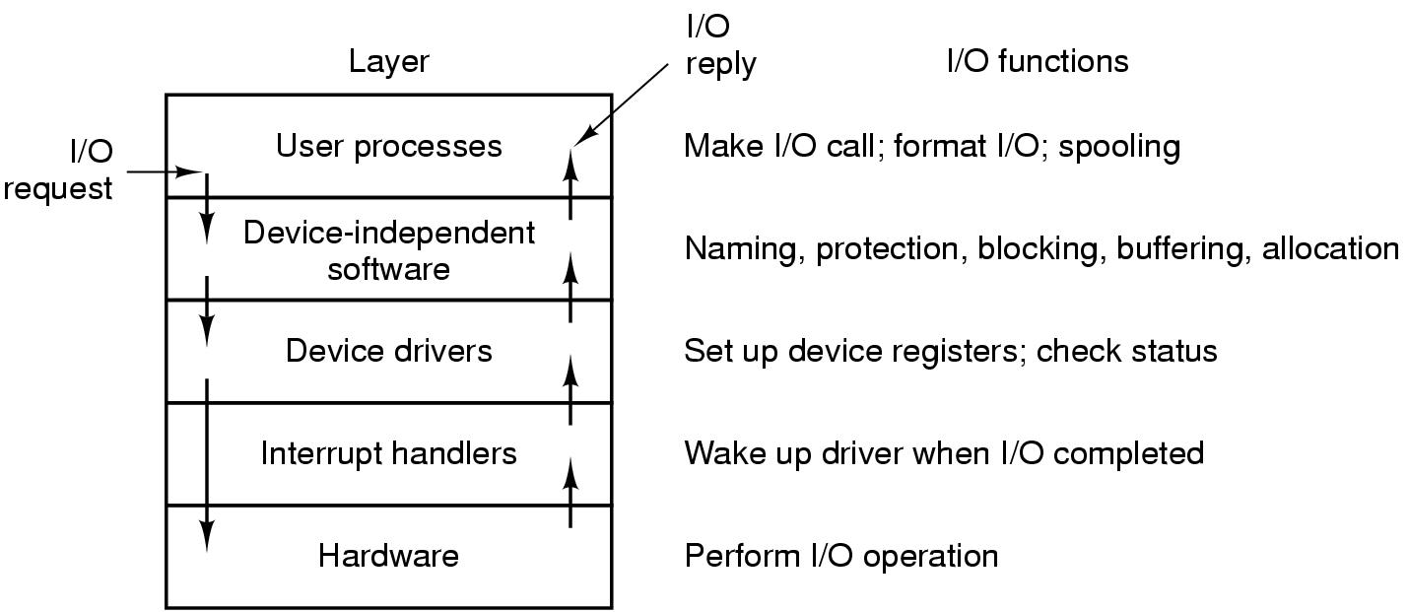
Anatomy of an I/O request

Slide 9
Device Driver goals
Device independence
Programs can access any I/O device
No need to specify device in advance
Uniform naming
Name of a file or device is a string or an integer
Doesn’t depend on the machine (underlying hardware)
Error handling
Done as close to the hardware as possible
Isolate from higher-level software
Synchronous vs. asynchronous transfers
Blocked transfers vs. interrupt-driven
Buffering
Data coming off a device cannot be stored in final destination
Sharable vs. dedicated devices

Slide 10
Memory-Mapped vs. separate I/O Space
Memory
0xFFF…
I/O ports
0
Separate I/O & memory space
Memory-mapped I/O
Hybrid: both memory-mapped & separate spaces

Slide 11
Example: Dynamic Frequency on XScale

Slide 12
Programmed I/O example: printing a page
User
Printed page
Printed page
Printed page
ABCD EFGH
ABCD EFGH
ABCD EFGH
A
AB
Kernel
ABCD EFGH
ABCD EFGH

Slide 13
Polling
copy_from_user (buffer, p, count); // copy into kernel buffer
for (j = 0; j < count; j++) { // loop for each char
while (*printer_status_reg != READY)
; // wait for printer to be ready
*printer_data_reg = p[j]; // output a single character
}
return_to_user();

Slide 14
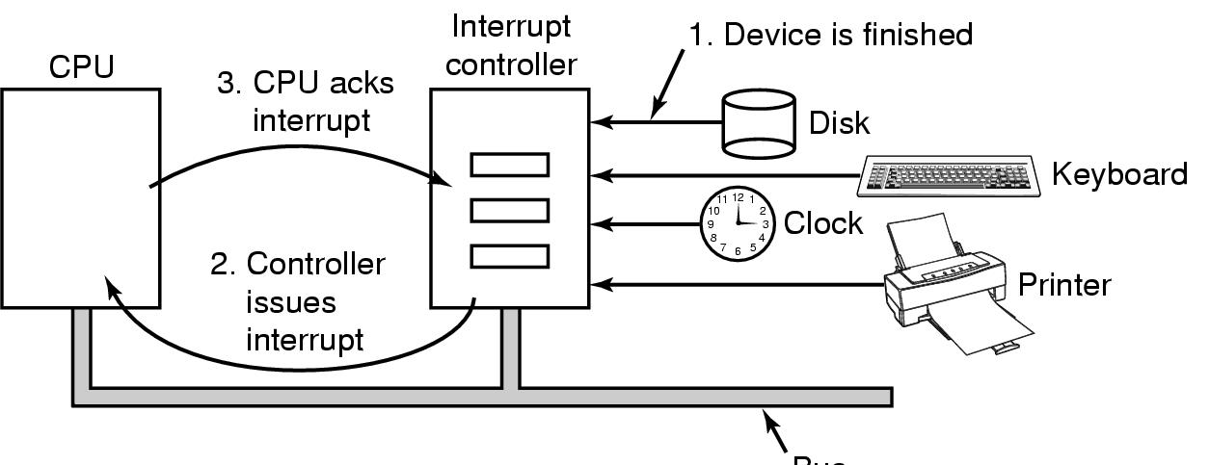
Hardware’s view of interrupts
Bus

Slide 15
Interrupt-driven I/O
copy_from_user (buffer, p, count);
j = 0;
enable_interrupts();
while (*printer_status_reg != READY)
;
*printer_data_reg = p[0];
scheduler(); // and block user
Code run by system call
if (count == 0) {
unblock_user();
} else {
j++;
*printer_data_reg = p[j];
count--;
}
acknowledge_interrupt();
return_from_interrupt();
Code run at interrupt time
(Interrupt handler)

Slide 16
What happens on an interrupt
Set up stack for interrupt service procedure
Ack interrupt controller, reenable interrupts
Copy registers from where saved
Run service procedure
(optional) Pick a new process to run next
Set up MMU context for process to run next
Load new process' registers
Start running the new process

Slide 17
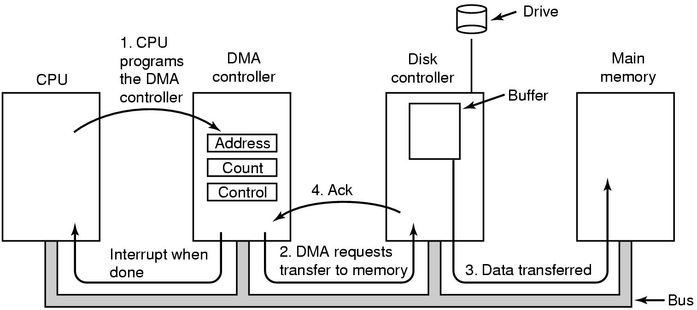
Direct Memory Access (DMA) operation

Slide 18
I/O using DMA
copy_from_user (buffer, p, count);
set_up_DMA_controller();
scheduler(); // and block user
Code run by system call
acknowledge_interrupt();
unblock_user();
return_from_interrupt();
Code run at interrupt time

Slide 19
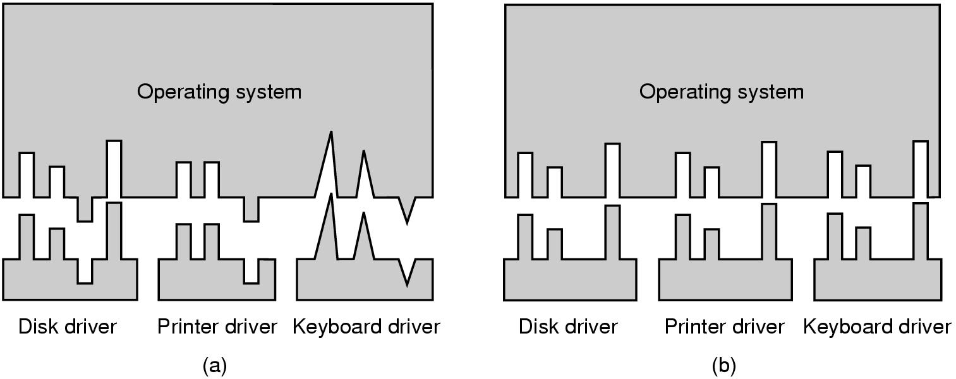
Why a standard driver interface?
Non-standard driver interfaces
Standard driver interfaces

Slide 20
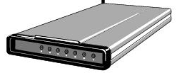
Buffering device input
User space
User space
User space
User space
Kernel space
Kernel space
Kernel space
Kernel space
2
2
1
1
3
Unbuffered input
Buffering in user space
Buffer in kernel Copy to user space
Double buffer in kernel

Slide 21
Disk drive structure
Data stored on surfaces
Up to two surfaces per platter
One or more platters per disk
Data in concentric tracks
Tracks broken into sectors
256B-1KB per sector
Cylinder: corresponding tracks on all surfaces
Data read and written by heads
Actuator moves heads
Heads move in unison
head
sector
platter
track
cylinder
surfaces
spindle
actuator

Slide 22
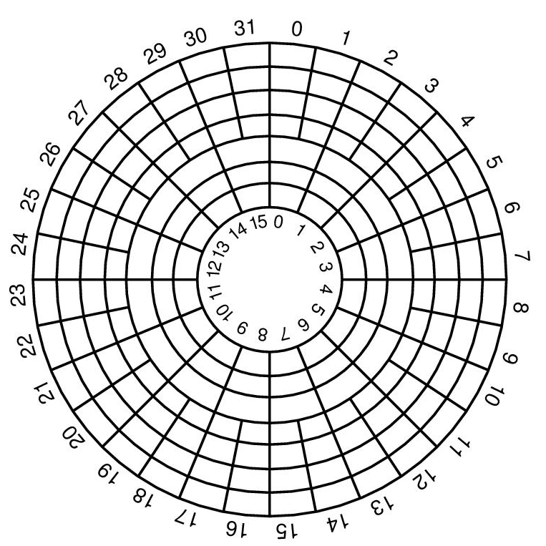
Disk “zones”
Outside tracks are longer than inside tracks
Two options
Bits are “bigger”
More bits (transfer faster)
Modern hard drives use second option
More data on outer tracks
Disk divided into “zones”
Constant sectors per track in each zone
8–20 (or more) zones on a disk

Slide 23
What’s in a disk request?
Time required to read or write a disk block determined by 3 factors
Seek time
Rotational delay
Average delay = 1/2 rotation time
Example: rotate in 10ms, average rotation delay = 5ms
Actual transfer time
Transfer time = time to rotate over sector
Example: rotate in 10ms, 200 sectors/track => 10/200 ms = 0.05ms transfer time per sector
Seek time dominates, with rotation time close
Error checking is done by controllers

Slide 24
Disk drive specifics
 | IBM 360KB floppy | WD 18GB HD
Cylinders | 40 | 10601
Tracks per cylinder | 2 | 12
Sectors per track | 9 | 281 (average)
Sectors per disk | 720 | 35742000
Bytes per sector | 512 | 512
Capacity | 360 KB | 18.3 GB
Seek time (minimum) | 6 ms | 0.8 ms
Seek time (average) | 77 ms | 6.9 ms
Rotation time | 200 ms | 8.33 ms
Spinup time | 250 ms | 20 sec
Sector transfer time | 22 ms | 17 μsec

Slide 25
Disk scheduling algorithms
Schedule disk requests to minimize disk seek time
Seek time increases as distance increases (though not linearly)
Minimize seek distance -> minimize seek time
Disk seek algorithm examples assume a request queue & head position (disk has 200 cylinders)
Queue = 100, 175, 51, 133, 8, 140, 73, 77
Head position = 63
Outside edge
Inside edge
8
51
73
100
133
175
77
140
read/write head position
disk requests
(cylinder in which block resides)

Slide 26
First-Come-First Served (FCFS)
Requests serviced in the order in which they arrived
Easy to implement!
May involve lots of unnecessary seek distance
Seek order = 100, 175, 51, 133, 8, 140, 73, 77
Seek distance = (100-63) + (175-100) + (175-51) + (133-51) + (133-8) + (140-8) + (140-73) + (77-73) = 646 cylinders
read/write head start
100
175
51
133
8
140
73
77

Slide 27
Shortest Seek Time First (SSTF)
Service the request with the shortest seek time from the current head position
Form of SJF scheduling
May starve some requests
Seek order = 73, 77, 100, 133, 140, 175, 51, 8
Seek distance = 10 + 4 + 23 + 33 + 7 + 35 + 124 + 43 = 279 cylinders
read/write head start
73
77
51
8
133
100
140
175

Slide 28
SCAN (elevator algorithm)
Disk arm starts at one end of the disk and moves towards the other end, servicing requests as it goes
Reverses direction when it gets to end of the disk
Also known as elevator algorithm
Seek order = 51, 8, 0 , 73, 77, 100, 133, 140, 175
Seek distance = 12 + 43 + 8 + 73 + 4 + 23 + 33 + 7 + 35 = 238 cyls
read/write head start
51
8
73
77
100
133
140
175

Slide 29
C-SCAN
Identical to SCAN, except head returns to cylinder 0 when it reaches the end of the disk
Treats cylinder list as a circular list that wraps around the disk
Waiting time is more uniform for cylinders near the edge of the disk
Seek order = 73, 77, 100, 133, 140, 175, 199, 0, 8, 51
Distance = 10 + 4 + 23 + 33 + 7 + 35 + 24 + 199 + 8 + 43 = 386 cyls
read/write head start
73
77
100
133
140
175
8
51

Slide 30
C-LOOK
Identical to C-SCAN, except head only travels as far as the last request in each direction
Saves seek time from last sector to end of disk
Seek order = 73, 77, 100, 133, 140, 175, 8, 51
Distance = 10 + 4 + 23 + 33 + 7 + 35 + 167 + 43 = 322 cylinders
read/write head start
73
77
100
133
140
175
8
51

Slide 31
Long-term information storage
Must store large amounts of data
Gigabytes -> terabytes -> petabytes
Stored information must survive the termination of the process using it
Lifetime can be seconds to years
Must have some way of finding it!
Multiple processes must be able to access the information concurrently

Slide 32
Naming files
Important to be able to find files after they’re created
Every file has at least one name
Name can be
Human-accessible: “foo.c”, “my photo”, “Go Panthers!”, “Go Steelers!”
Machine-usable: 4502, 33481
Case may or may not matter
Depends on the file system
Name may include information about the file’s contents
Certainly does for the user (the name should make it easy to figure out what’s in it!)
Computer may use part of the name to determine the file type

Slide 33
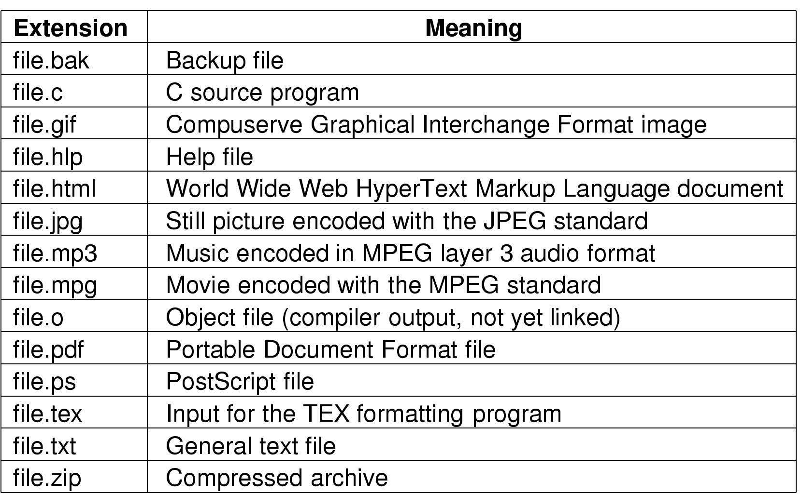
Typical file extensions

Slide 34
File structures
1 record
1 byte
401
445
1550
jr
th
tj
bg
sk
jm
dm
sk
Sequence of bytes
Sequence of records
S18
F18
S19
Tree

Slide 35
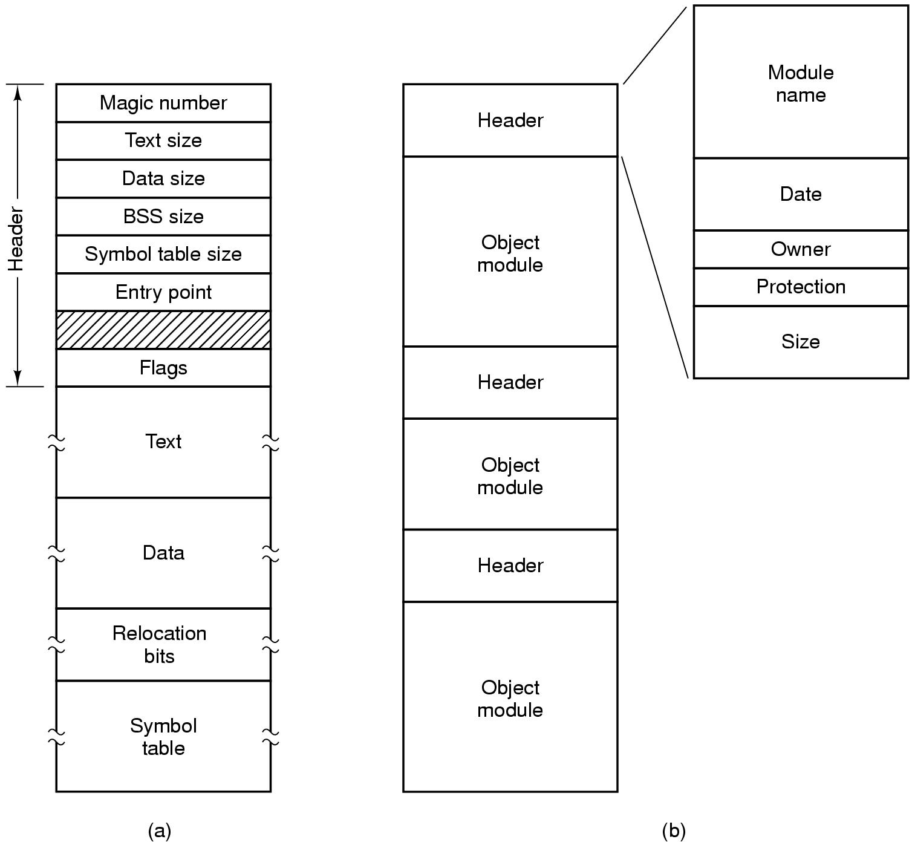
File types
Executable file
Archive

Slide 36
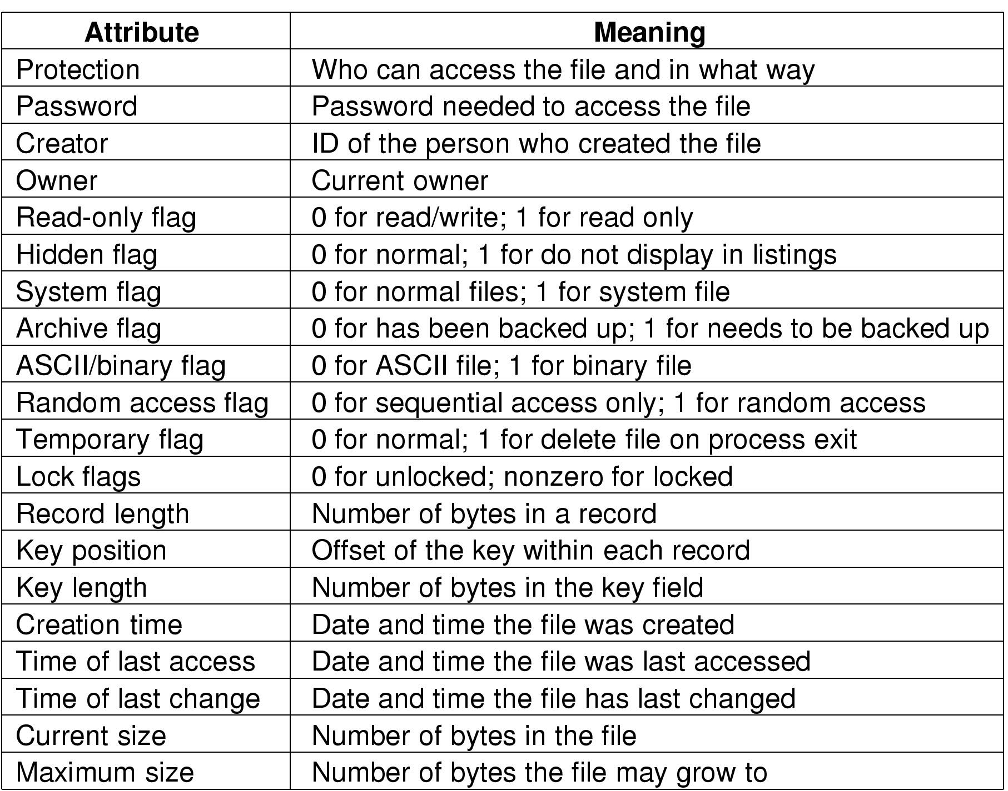
File attributes

Slide 37
File operations
Create: make a new file
Delete: remove an existing file
Open: prepare a file to be accessed
Close: indicate that a file is no longer being accessed
Read: get data from a file
Write: put data to a file
Append: like write, but only at the end of the file
Seek: move the “current” pointer elsewhere in the file
Get attributes: retrieve attribute information
Set attributes: modify attribute information
Rename: change a file’s name

Slide 38
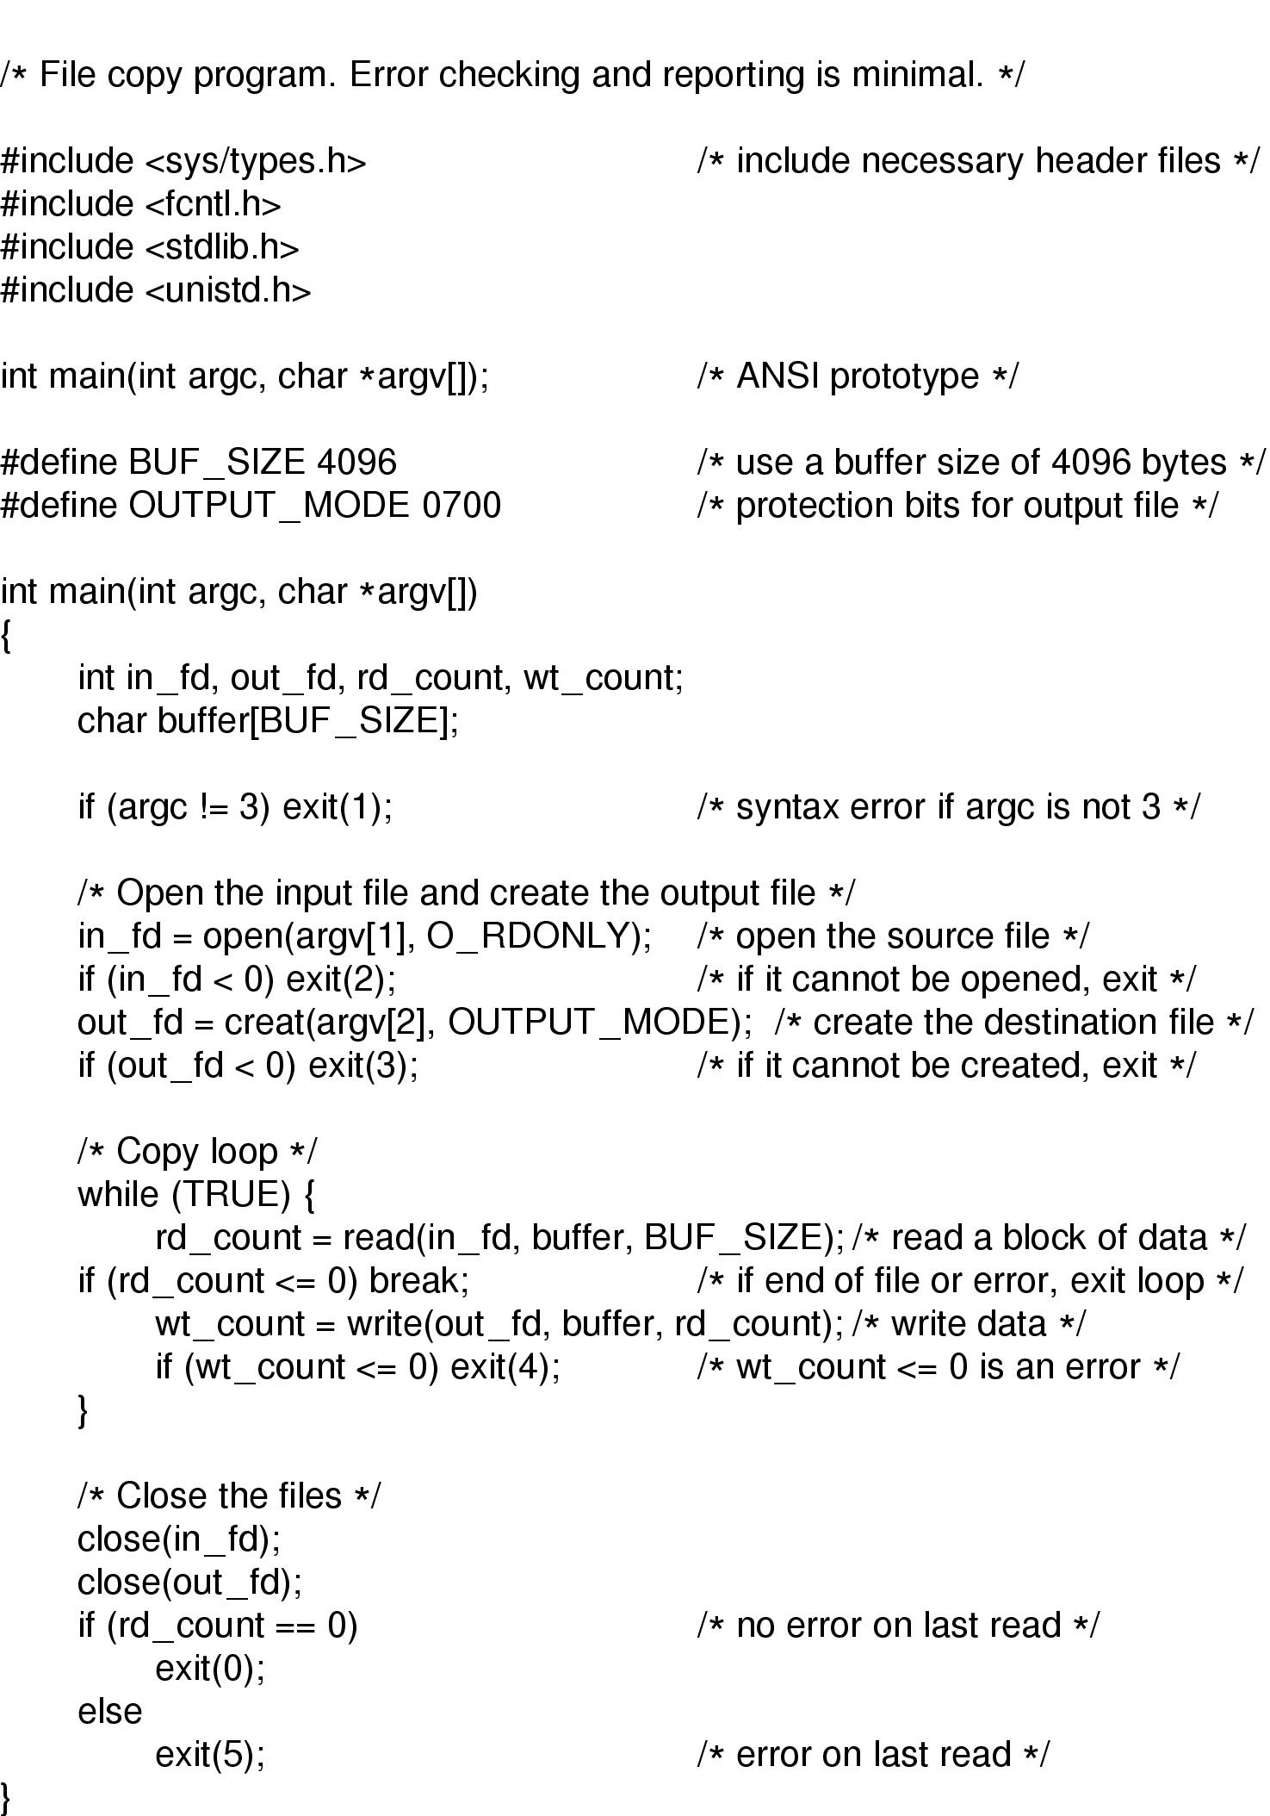
Using file system calls

Slide 39
Using file system calls, continued

Slide 40
Directories
Naming is nice, but limited
Humans like to group things together for convenience
File systems allow this to be done with directories (sometimes called folders)
Grouping makes it easier to
Find files in the first place: remember the enclosing directories for the file
Locate related files (or just determine which files are related)

Slide 41
Single-level directory systems
One directory in the file system
Example directory
Contains 4 files (foo, bar, baz, blah)
owned by 3 different people: A, B, and C (owners shown in red)
Problem: what if user B wants to create a file called foo?
Root directory
A foo
A bar
B baz
C blah

Slide 42
Two-level directory system
Solves naming problem: each user has her own directory
Multiple users can use the same file name
By default, users access files in their own directories
Extension: allow users to access files in others’ directories
Root directory
A
B
C
A foo
A bar
B foo
B baz
C bar
C foo
C blah

Slide 43
Hierarchical directory system
Root directory
A
B
C
A
Papers
A foo
A
Photos
B foo
B
Papers
C bar
C foo
C blah
A os.tex
A sunset
A
Family
B foo.tex
B foo.ps
A sunset
A kids
A Mom

Slide 44
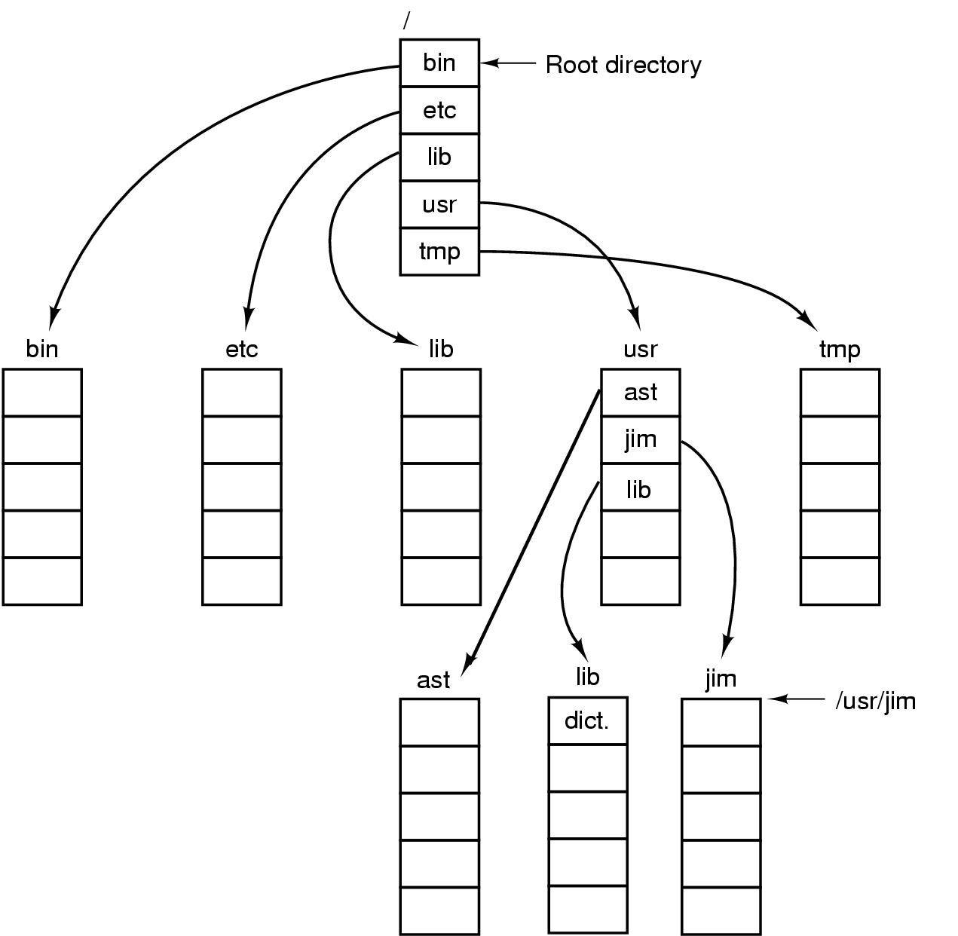
Unix directory tree

Slide 45
Operations on directories
Create: make a new directory
Delete: remove a directory (usually must be empty)
Opendir: open a directory to allow searching it
Closedir: close a directory (done searching)
Readdir: read a directory entry
Rename: change the name of a directory
Similar to renaming a file
Link: create a new entry in a directory to link to an existing file
Unlink: remove an entry in a directory
Remove the file if this is the last link to this file

Slide 46
File system implementation issues
How are disks divided up into file systems?
How does the file system allocate blocks to files?
How are directories handled?
How does the file system manage free space?
How can the file system improve…
Performance?
Reliability?

Slide 47
Carving up the disk
Entire disk
Partition table
Master boot record
Partition 1
Partition 2
Partition 3
Partition 4
Boot block
Super block
Free space management
Index nodes
Files & directories

Slide 48
Contiguous allocation for file blocks
Contiguous allocation requires all blocks of a file to be consecutive on disk
Problem: deleting files leaves “holes”
Similar to memory allocation issues
Compacting the disk can be a very slow procedure…
A
B
C
D
E
F
A
Free
C
Free
E
F

Slide 49
Contiguous allocation
Data in each file is stored in consecutive blocks on disk
Simple & efficient indexing
Starting location (block #) on disk (start)
Length of the file in blocks (length)
Random access well-supported
Difficult to grow files
Must pre-allocate all needed space
Wasteful of storage if file isn’t using all of the space
Logical to physical mapping is easy blocknum = (pos / 1024) + start; offset_in_block = pos % 1024;
0
1
2
3
4
5
6
7
8
9
10
11
Start=5
Length=2902

Slide 50
Linked allocation
File is a linked list of disk blocks
Blocks may be scattered around the disk drive
Block contains both pointer to next block and data
Files may be as long as needed
New blocks are allocated as needed
Linked into list of blocks in file
Removed from list (bitmap) of free blocks
0
1
2
3
4
6
4
5
6
7
x
x
8
9
10
11
0
Start=9
End=4
Length=2902
Start=3
End=6
Length=1500

Slide 51
Finding blocks with linked allocation
Directory structure is simple
Starting address looked up from directory
Directory only keeps track of first block (not others)
No wasted blocks - all blocks can be used
Random access is difficult: must always start at first block!
Logical to physical mapping is done by block = start; offset_in_block = pos % 1020; for (j = 0; j < pos / 1020; j++) { block = block->next; }
Assumes that next pointer is stored at end of block
May require a long time for seek to random location in file

Slide 52
File Allocation Table (FAT)
Links on disk are slow
Keep linked list in memory
Advantage: faster
Disadvantages
Have to copy it to disk at some point
Have to keep in-memory and on-disk copy consistent
0
4
1
-1
2
-1
3
-2
4
-2
5
-1
6
3
B
7
-1
8
-1
9
0
A
10
-1
11
-1
12
-1
13
-1
14
-1
15
-1

Slide 53
Using a block index for allocation
Store file block addresses in an array
Array itself is stored in a disk block
Directory has a pointer to this disk block
Non-existent blocks indicated by -1
Random access easy
Limit on file size?
Name index size
grades 4 4802
0
1
2
3
6
9
7
0
8
4
5
6
7
8
9
10
11

Slide 54
Unix Fast File System indexing scheme
protection mode
data
owner & group
data
.
.
.
timestamps
size
data
block count
•
data
•
.
.
.
link count
•
Direct pointers
.
.
.
data
•
•
•
data
•
.
.
.
•
•
single indirect
•
•
data
double indirect
•
•
data
•
•
•
•
.
.
.
triple indirect
•
•
•
inode
•
•
•
data

Slide 55
What’s in a directory?
Two types of information
File names
File metadata (size, timestamps, etc.)
Basic choices for directory information
Store all information in directory
Fixed size entries
Disk addresses and attributes in directory entry
Store names & pointers to index nodes (i-nodes)
attributes
games
attributes
games
mail
attributes
mail
attributes
news
attributes
news
attributes
research
attributes
research
Storing all information in the directory
Using pointers to index nodes
attributes

Slide 56
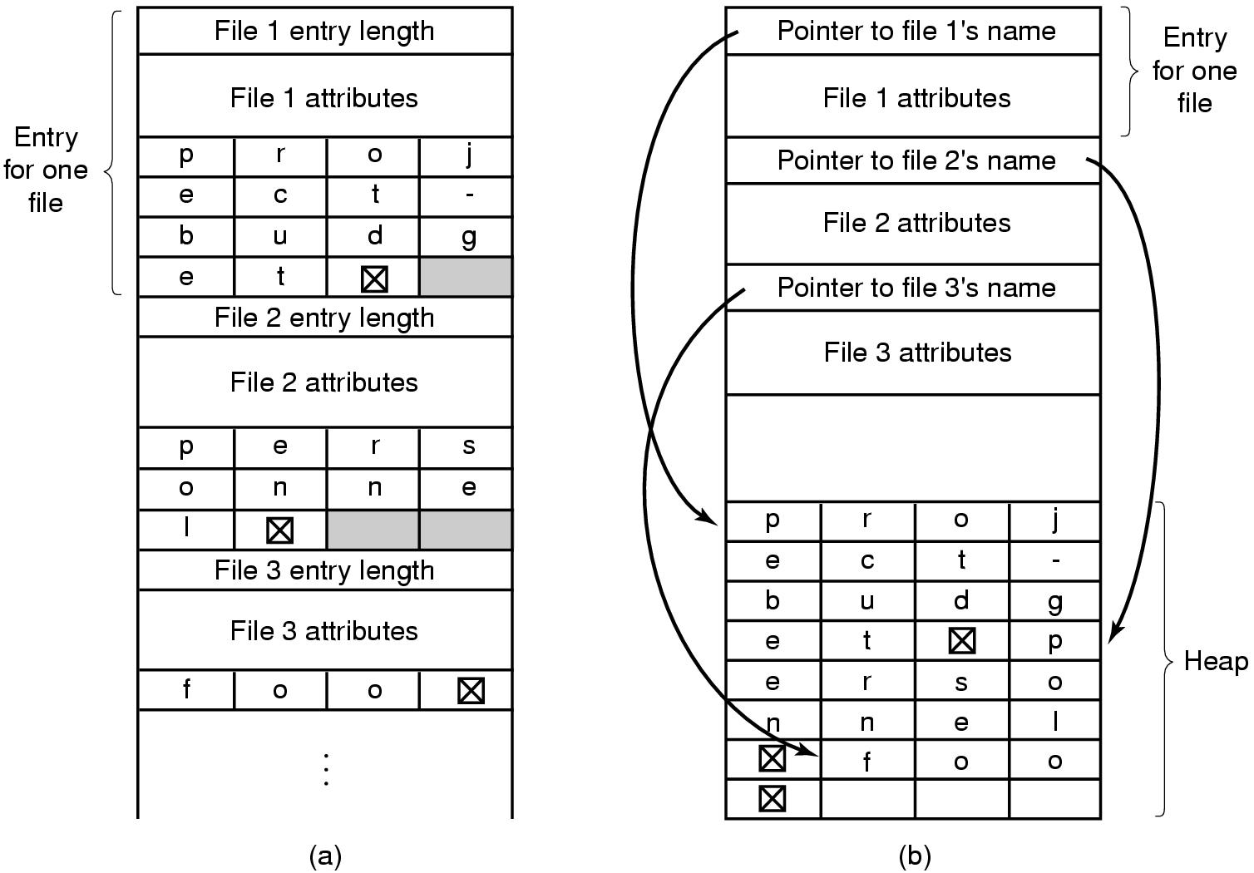
Handling long file names in a directory

Slide 57
Directories in FFS
Directories in FFS are just special files
Same basic mechanisms
Different internal structure
Directory entries contain
File name
I-node number
Other Unix file systems have more complex schemes
Not always simple files…
Directory
inode number
record length
name length
name
inode number
record length
name length
name

Slide 58
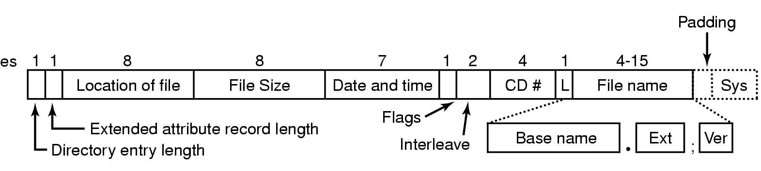
CD-ROM file system

Slide 59
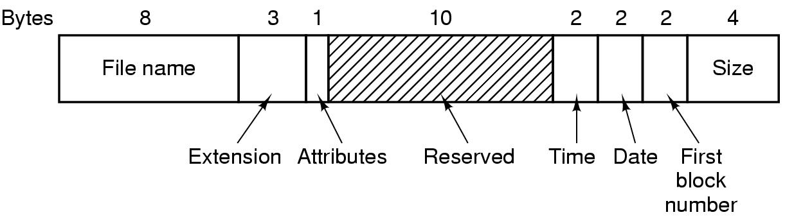
Directory entry in MS-DOS

Slide 60
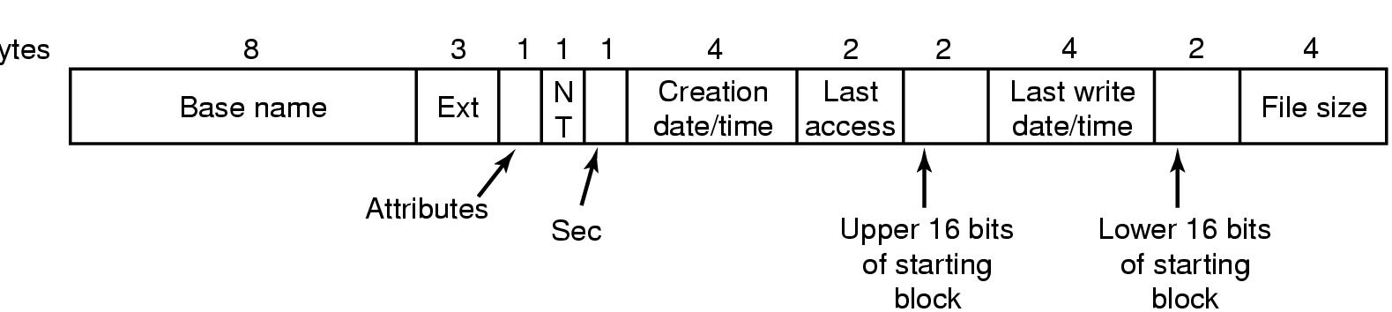
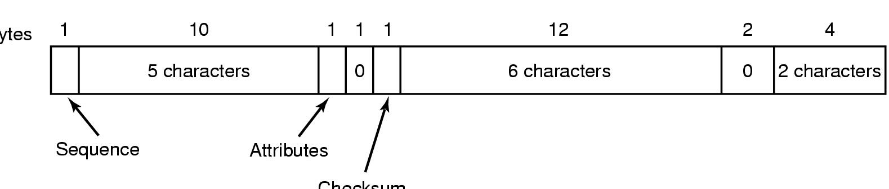
FAT32 Directory and Filename
Bytes
Checksum

Slide 61
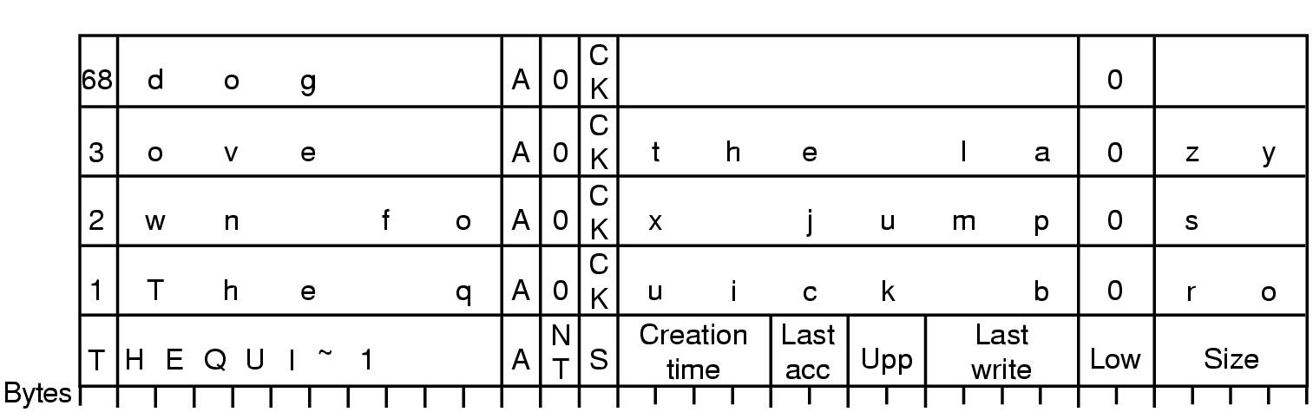
Storing a long name in FAT32
Long name stored in Windows 98 so that it’s backwards compatible with short names
Short name in “real” directory entry
Long name in “fake” directory entries: ignored by older systems
OS designers will go to great lengths to make new systems work with older systems…

Slide 62
Sharing files
Root directory
A
B
C
A
Papers
A foo
A
Photos
B foo
B
Photos
C bar
C foo
C blah
A os.tex
A sunset
A
Family
B lake
A sunset
A kids
? ???

Slide 63
Solution: use links
A creates a file, and inserts into her directory
B shares the file by creating a link to it
A unlinks the file
B still links to the file
Owner is still A (unless B explicitly changes it)
A
A
B
B
b.tex
b.tex
a.tex
a.tex
Owner: A Count: 1
Owner: A Count: 2
Owner: A Count: 1

Slide 64
Free Block Tracking
10

Slide 65
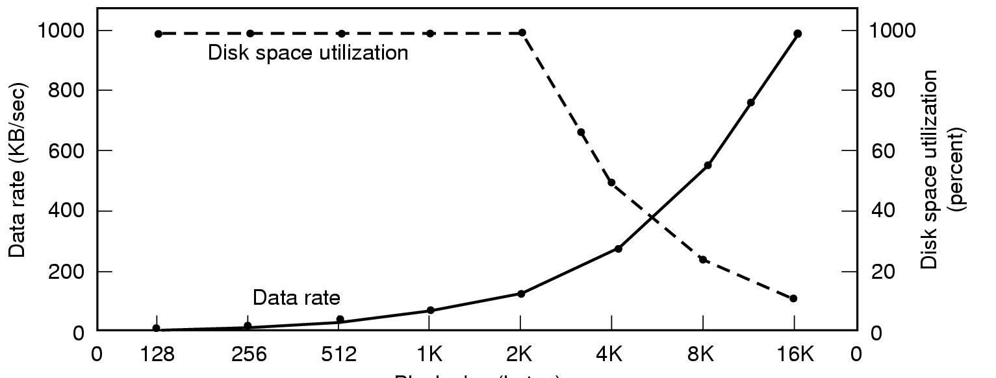
Disk block size
Dark line (left hand scale) gives data rate of a disk
Dotted line (right hand scale) gives disk space efficiency
All files 2KB
Block size

Slide 66
Max Partition Size
Block size | FAT-12 | FAT-16 | FAT-32
0.5 KB | 2 MB
1 KB | 4 MB
2 KB | 8 MB | 128 MB
4 KB | 16 MB | 256 MB | 1 TB
8 KB |  | 512 MB | 2 TB
16 KB |  | 1024 MB | 2 TB
32 KB |  | 2048 MB | 2 TB

Slide 67
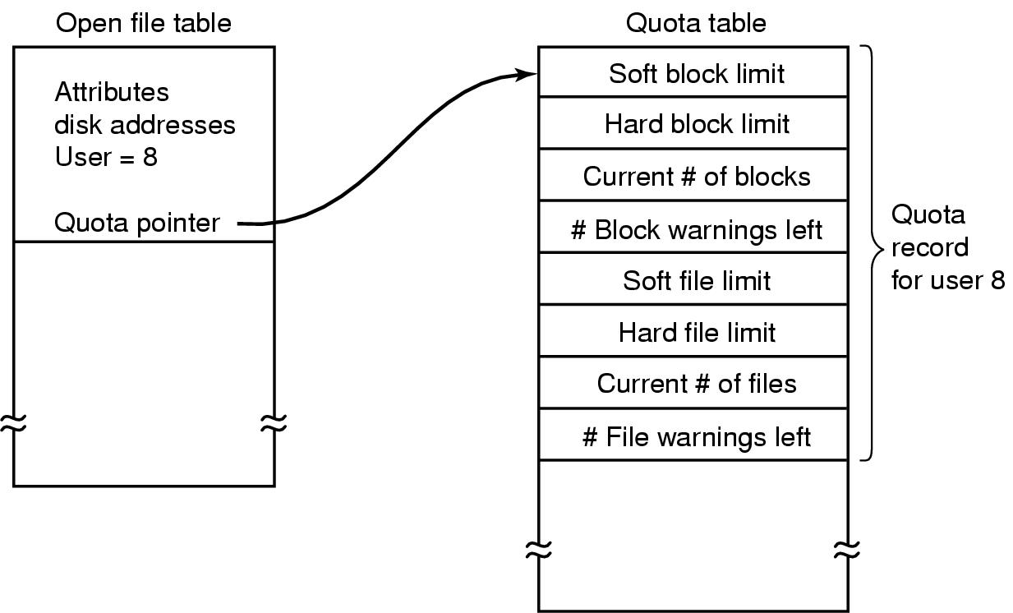
File-related kernel structures: open file tables and disk quotas

Slide 68
Structure of a disk sector
Preamble contains information about the sector
Sector number & location information
Data is usually 256, 512, or 1024 bytes
ECC (Error Correcting Code) is used to detect & correct minor errors in the data
Preamble
Data
ECC

Slide 69
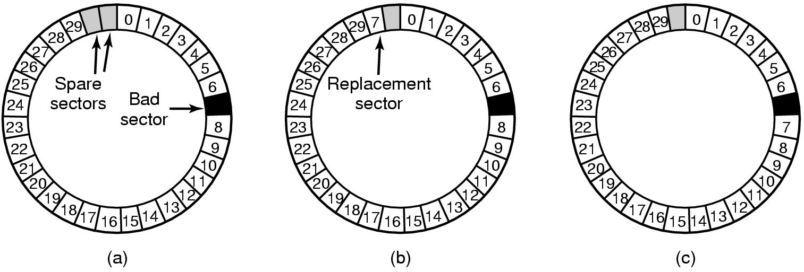
When good disks go bad…
Disks have defects
In 3M+ sectors, this isn’t surprising!
ECC helps with errors, but sometimes this isn’t enough
Disks keep spare sectors (normally unused) and remap bad sectors into these spares
If there’s time, the whole track could be reordered…

Slide 70
RAIDs, RAIDs, and more RAIDs
Stripe
strip
strip
RAID 0
(Redundant Array of Inexpensive Disks
RAID 1
(Mirrored copies)
RAID 4
(Striped with parity)
RAID 5
(Parity rotates through disks)

Slide 71
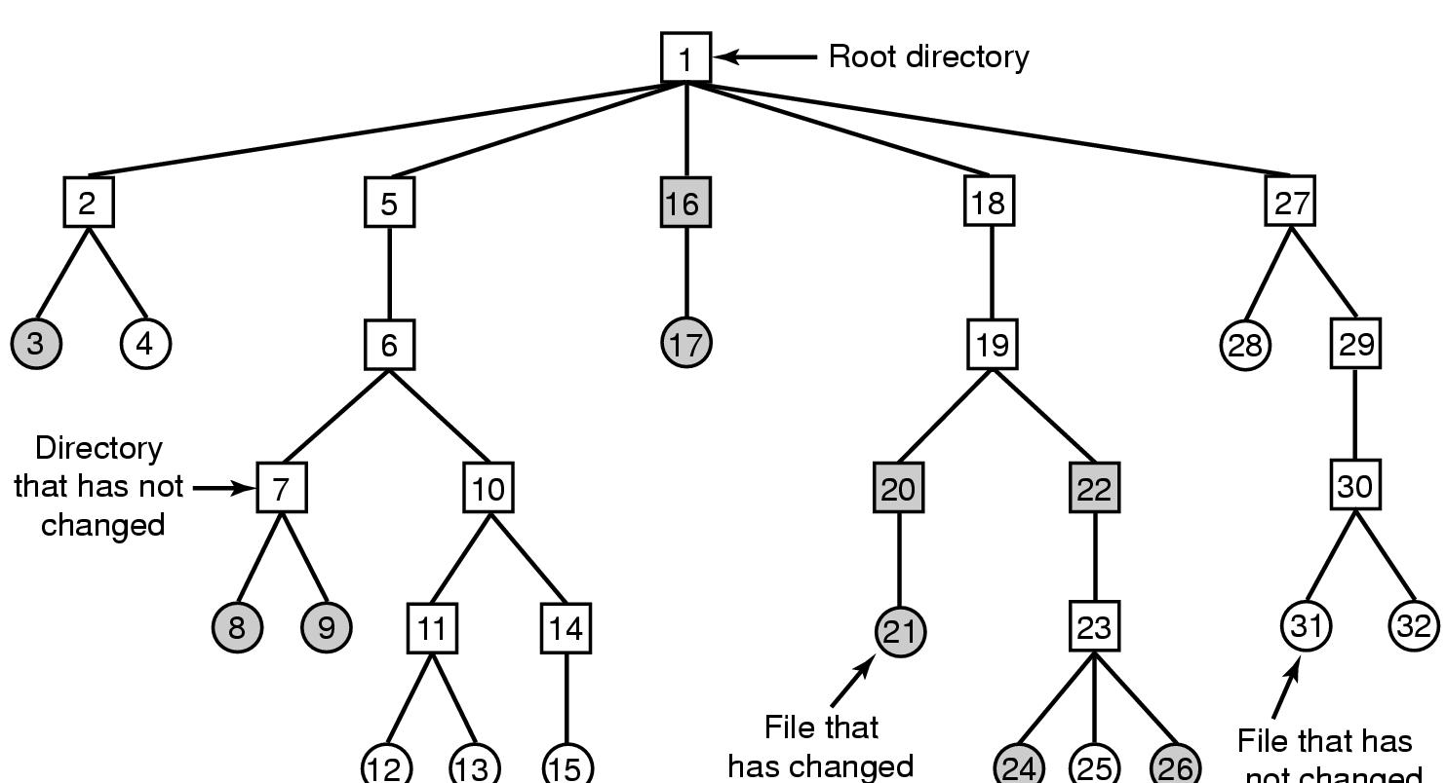
Backing up a file system
A file system to be dumped
Squares are directories, circles are files
Shaded items, modified since last dump
Each directory & file labeled by i-node number
File that has
not changed

Slide 72
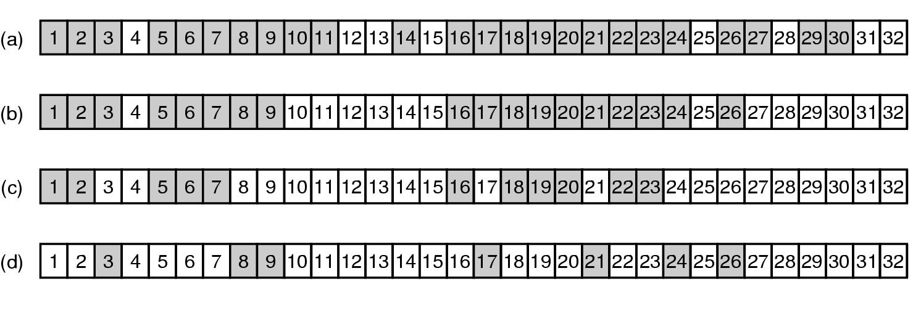
Bitmaps used in a file system dump

Slide 73
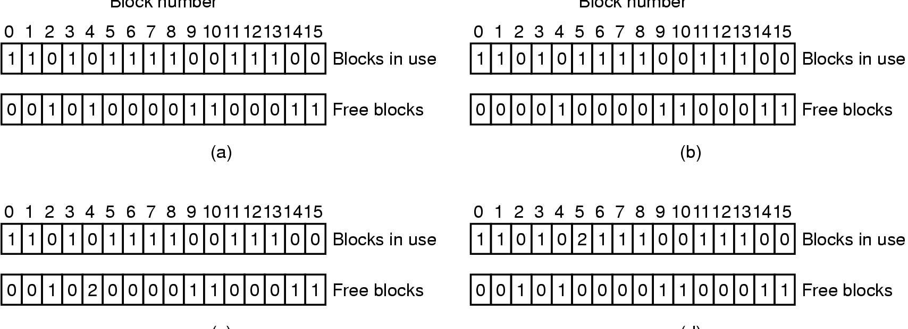
Checking the file system for consistency
Consistent
Missing (“lost”) block
Duplicate block in free list
Duplicate block in two files

Slide 74
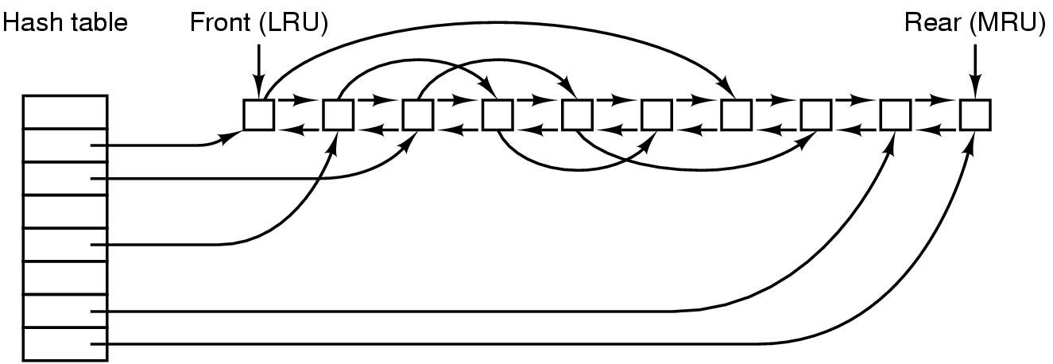
File block cache data structures

Slide 75
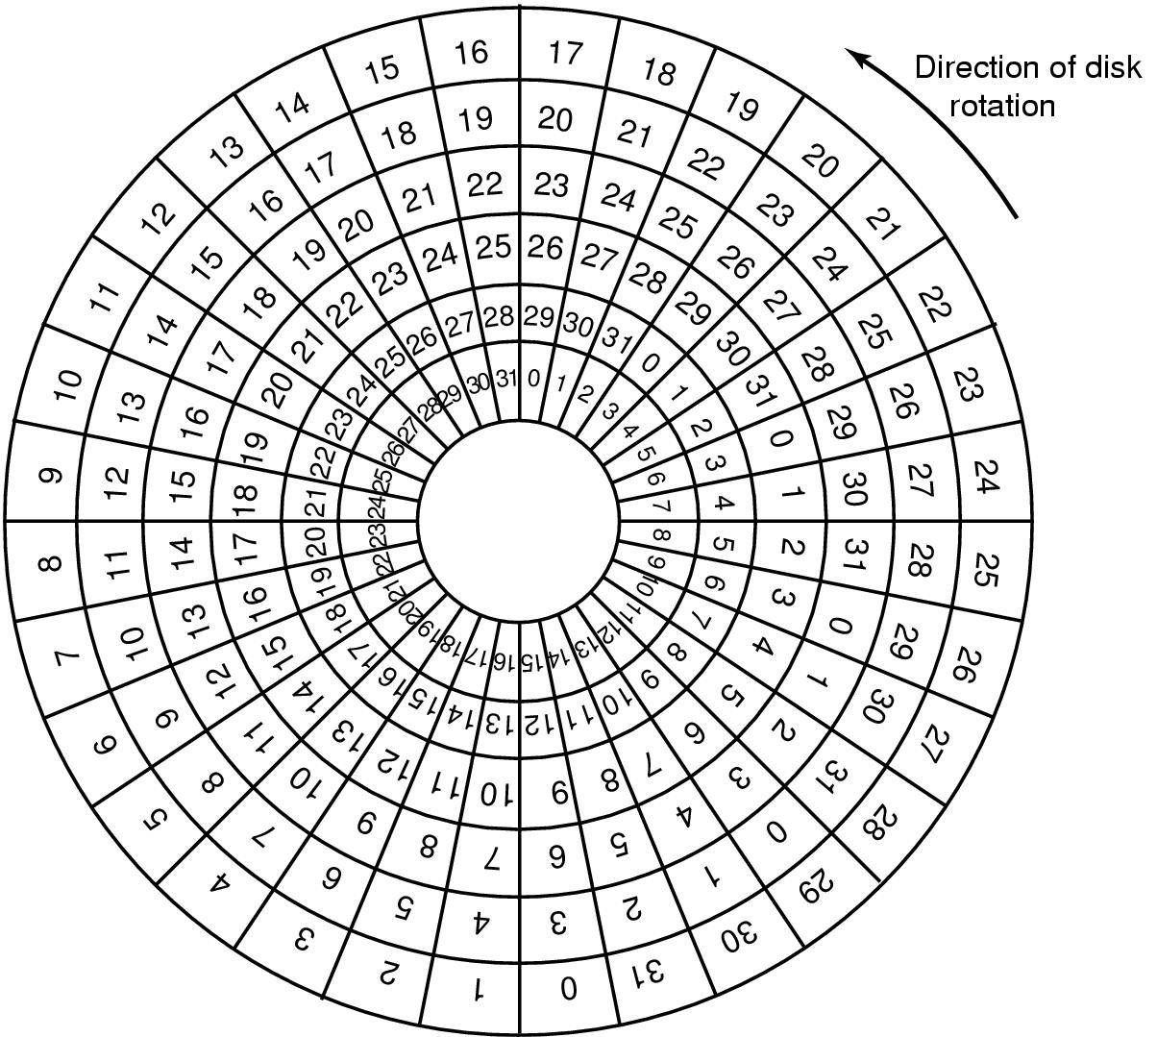
Sector Skew
Sectors numbered sequentially on each track
Numbering starts in different place on each track: sector skew
Allows time for switching head from track to track
All done to minimize delay in sequential transfers

Slide 76
Sector interleaving
On older systems, the CPU was slow => time elapsed between reading consecutive sectors
Solution: leave space between consecutively numbered sectors
This isn’t done much these days…
7
0
7
0
5
0
6
1
3
4
2
3
5
2
6
1
7
6
4
3
2
5
4
1
No interleaving
Skipping 1 sector
Skipping 2 sectors

Slide 77
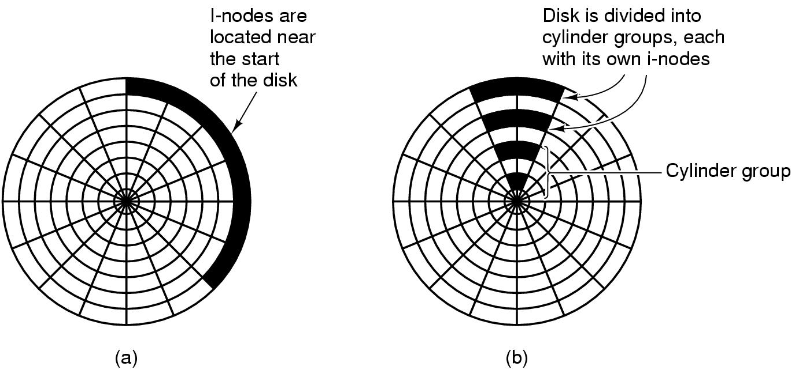
Grouping data on disk

Slide 78
Log-structured file systems
Trends in disk & memory
Faster CPUs
Larger memories
Result
More memory -> disk caches can also be larger
Increasing number of read requests can come from cache
Thus, most disk accesses will be writes
LFS structures entire disk as a log
All writes initially buffered in memory
Periodically write these to the end of the disk log
When file opened, locate i-node, then find blocks
Issue: what happens when blocks are deleted?

Slide 79
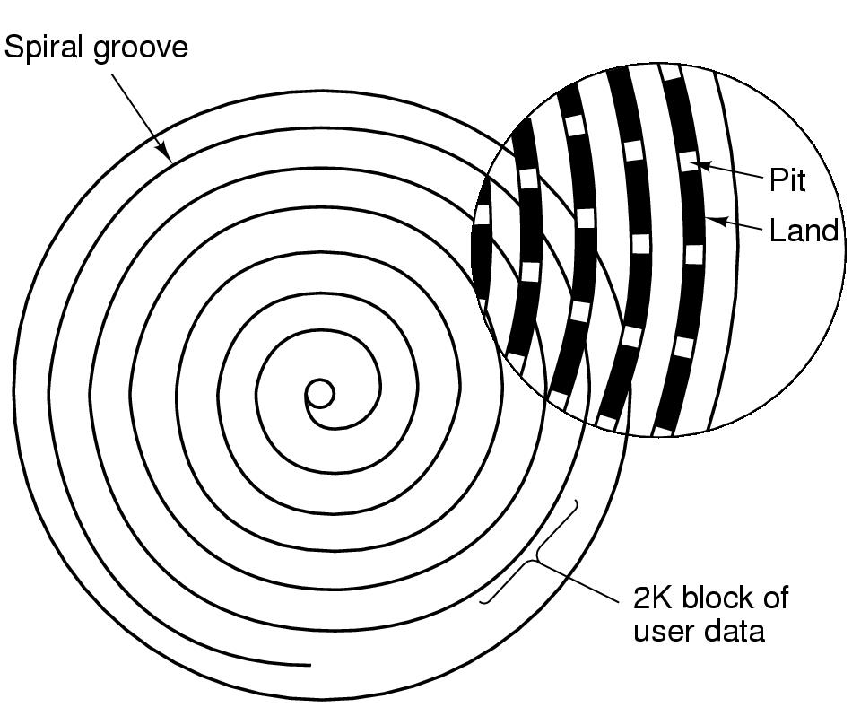
CD-ROM recording
CD-ROM has data in a spiral
Hard drives have concentric circles of data
One continuous track: just like vinyl records!
Pits & lands “simulated” with heat-sensitive material on CD-Rs and CD-RWs

Slide 80
Flash File System
Wear Leveling
Count total writes per flash sector and attempt to balance across the whole disk

